Slide 1
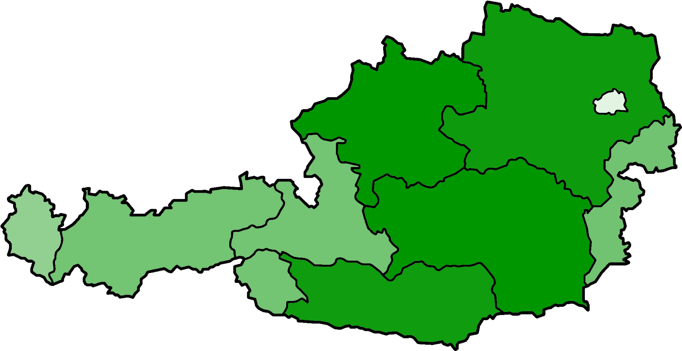
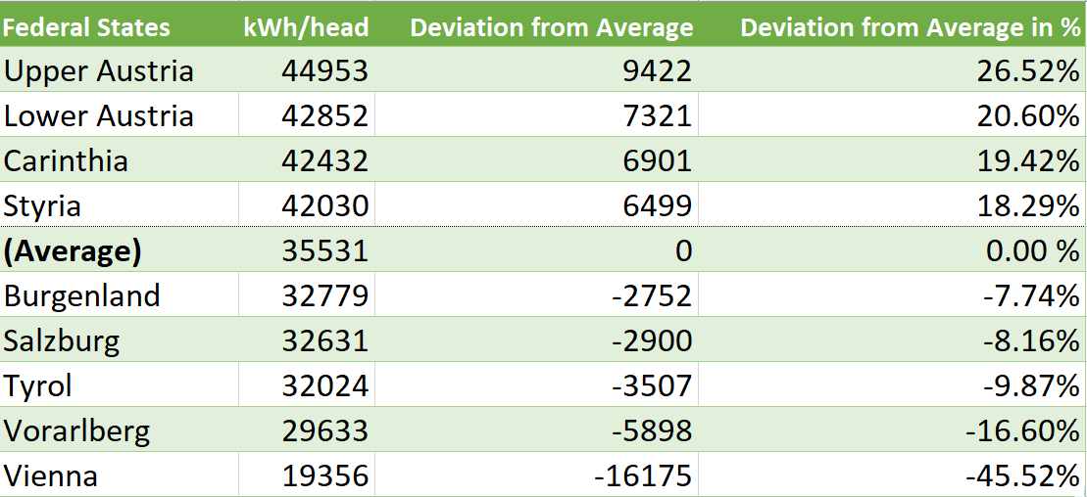
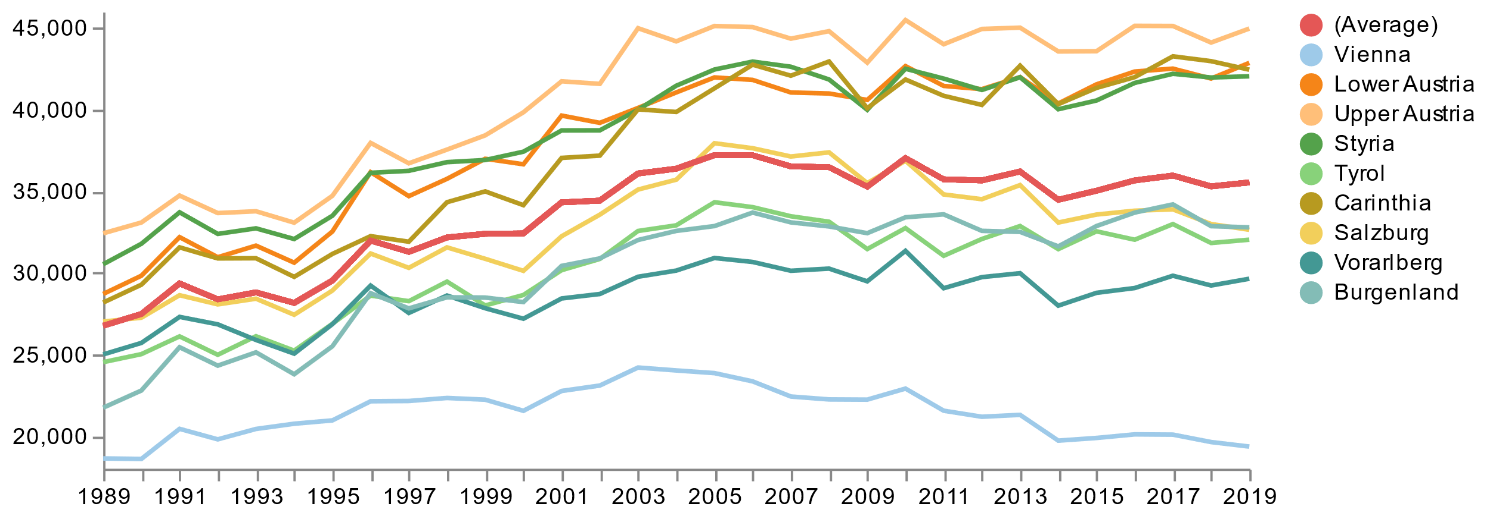
Energy Consumption per Capita in Austria
The final energy consumption represents the total energy used by households, industry and transport. The collected data from the years 1989 - 2019 show a significant increase in energy demand per capita in Austria. Vienna stands out from among the federal states with a very low energy consumption. Due to the greater use of public transport and the lower heating costs due to living in apartment buildings, energy consumption in a large city is lower than in the countryside. However, Vienna is also characterized by the lowest relative increase within the measurement period.
Energy Consumption in 2019 by Federal State
Energy Consumption in kWh/head by Federal State
Years 1989 - 2019
Low
High
A Positive Trend?
In the period from 1989 to 2005, average energy consumption increased significantly. Although annual fluctuations can be seen from 2005, the value in 2019 is almost at the level of 2005. This is certainly a positive development, but an additional reduction in per capita energy consumption would b urgently needed in view of the natural gas bottleneck caused by the Ukraine war and the constantly progressing climate change.

Slide 2
